Slide 1
Cairo
I have no idea for a caption...

Slide 2
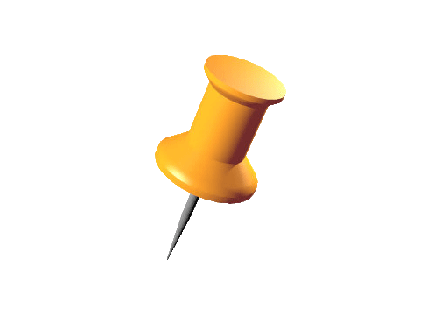
structure
1. general facts
2. history + some sights
3. places to visit
4. typical problems
5. sources

Slide 3
- capitol of Egypt
- 606 square kilometers (administrative area)
- 5360 square kilometers (metropolitian area)
- 9,15 mio. inhabitants (administrative area)
- 16,2 mio. inhabitants (metropolitian area)
-situated at the right shore of the Nile

Slide 4
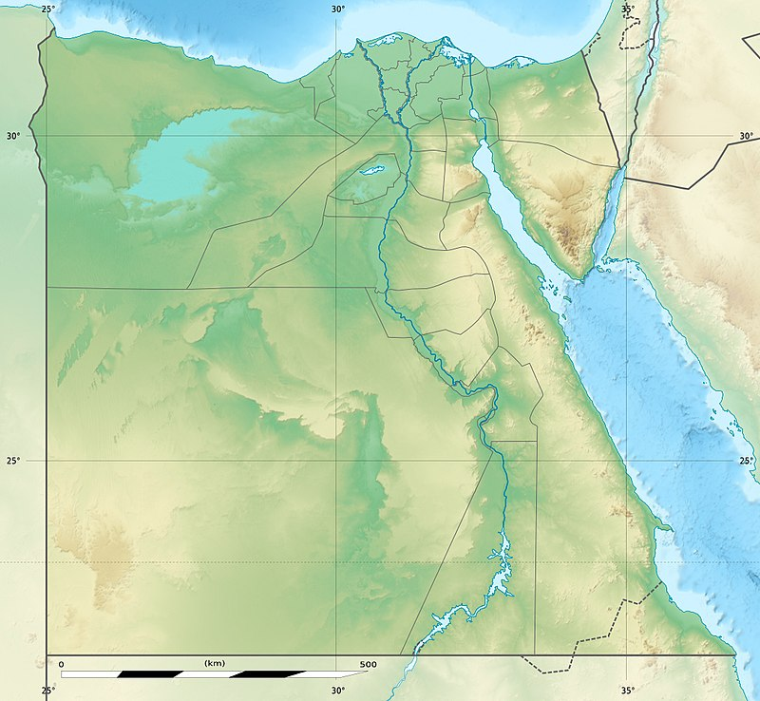

Slide 5
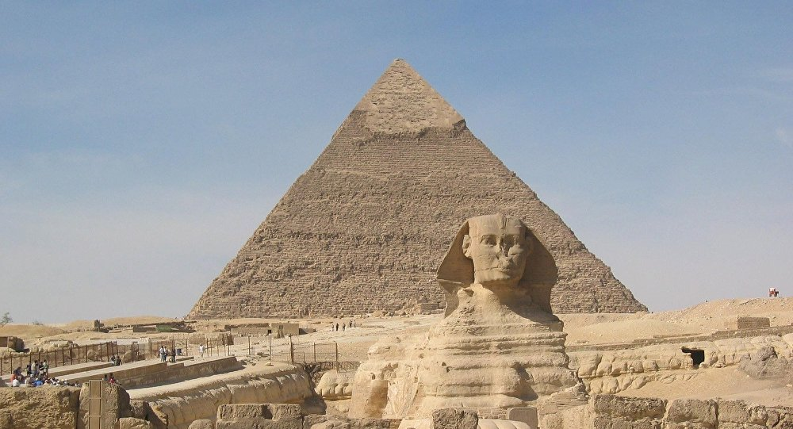
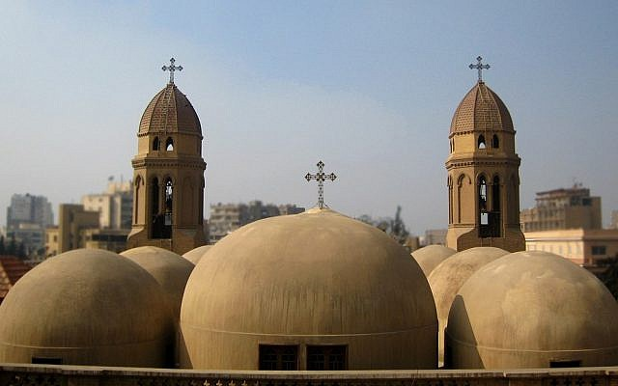

Slide 6
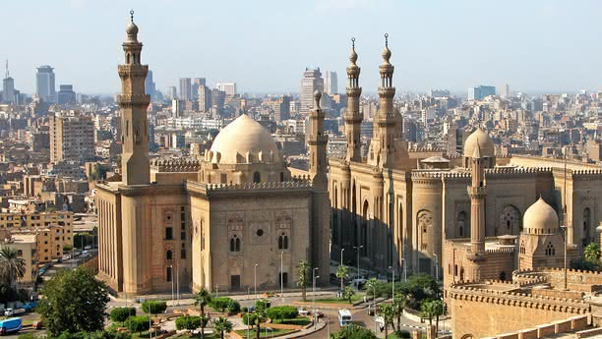
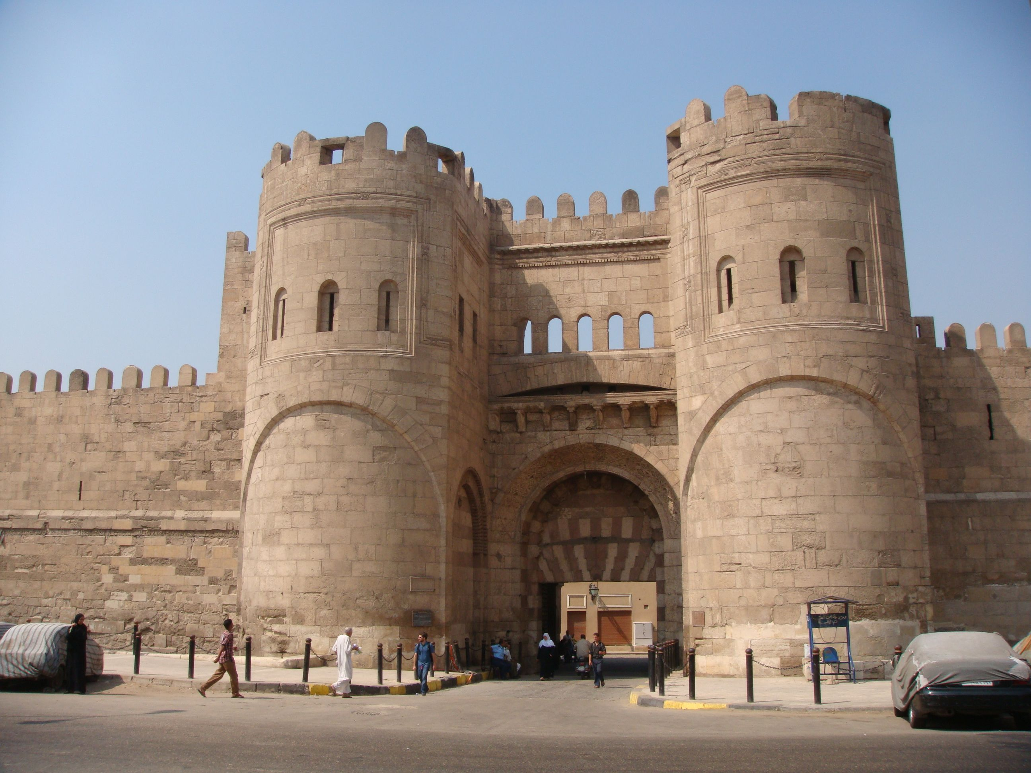
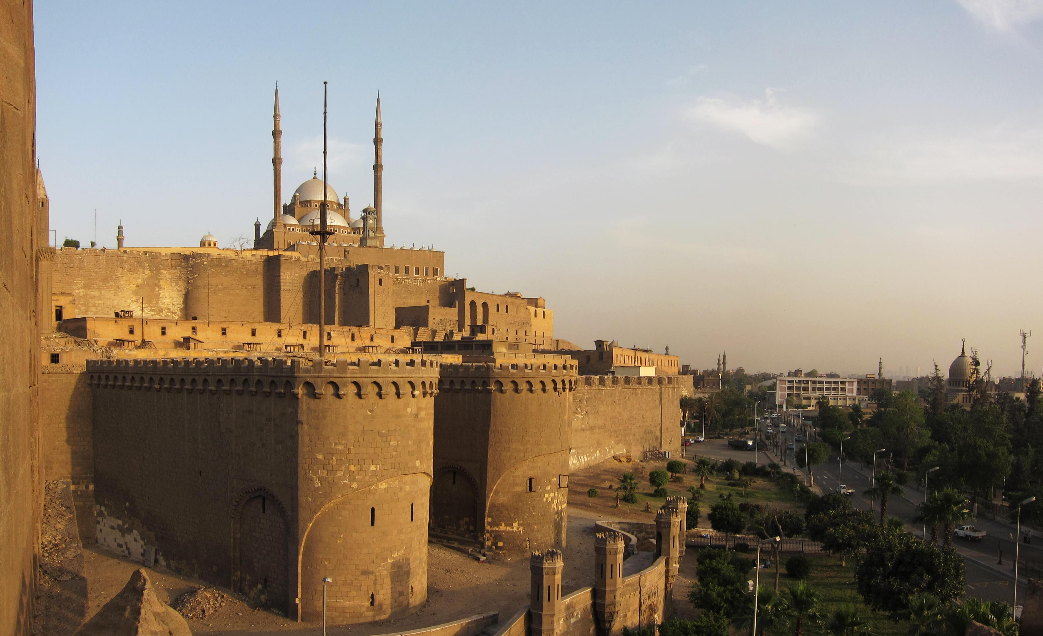

Slide 7
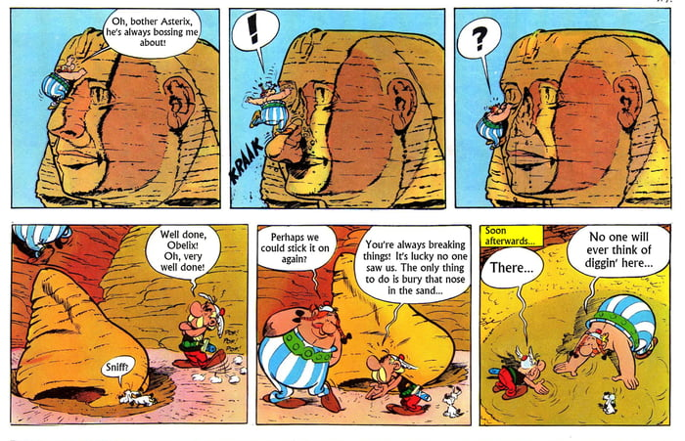

Slide 8
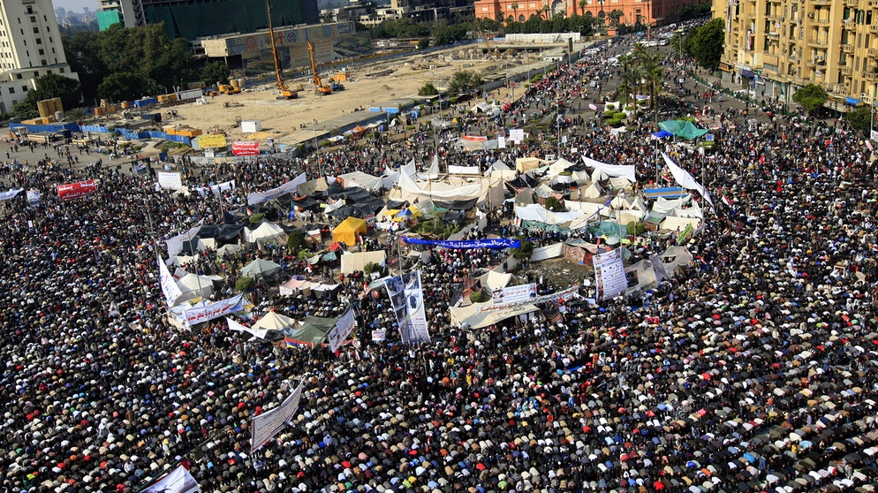

Slide 9
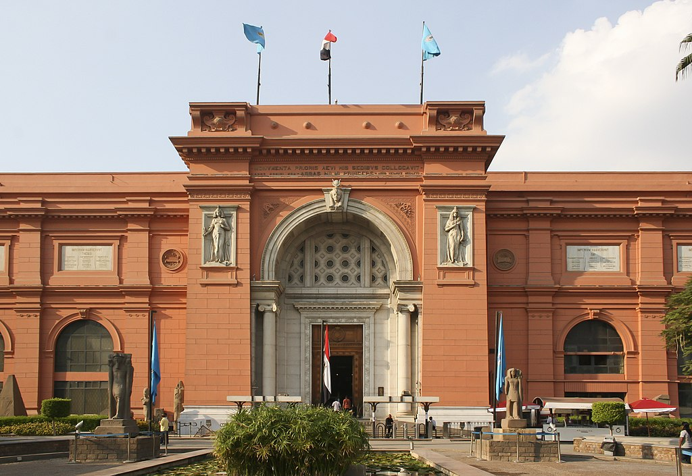
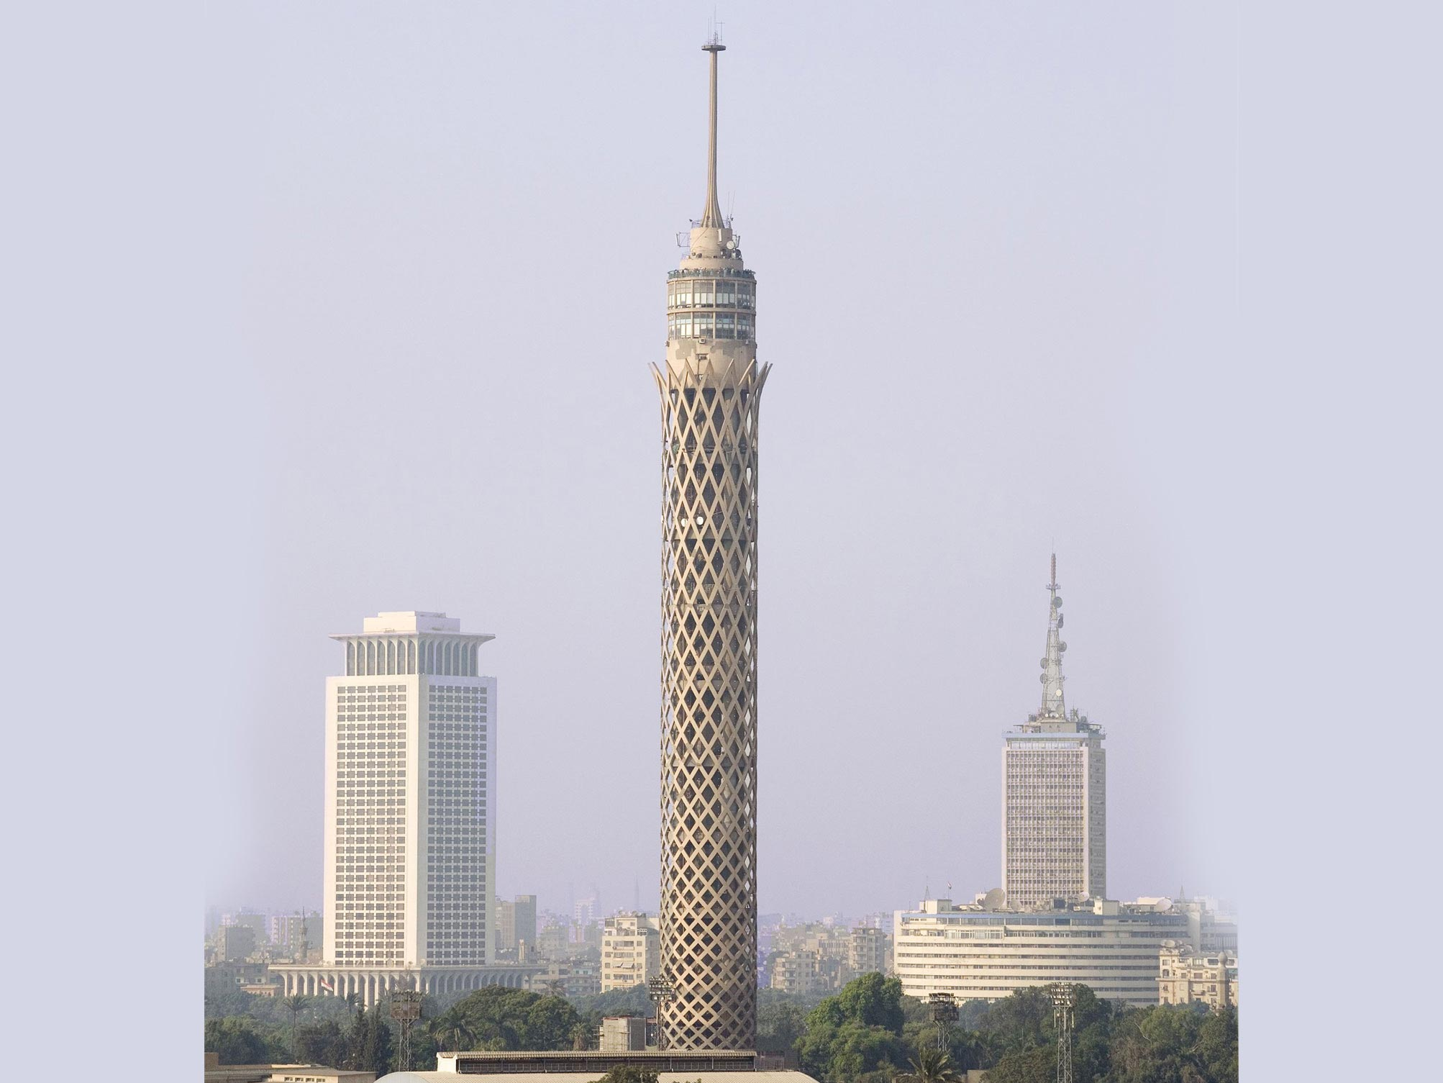

Slide 10
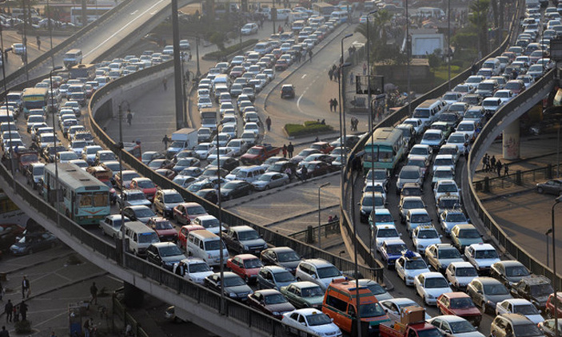
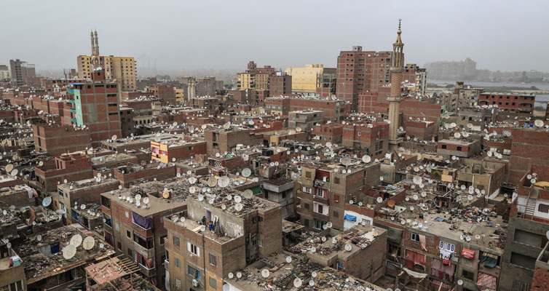

Slide 11
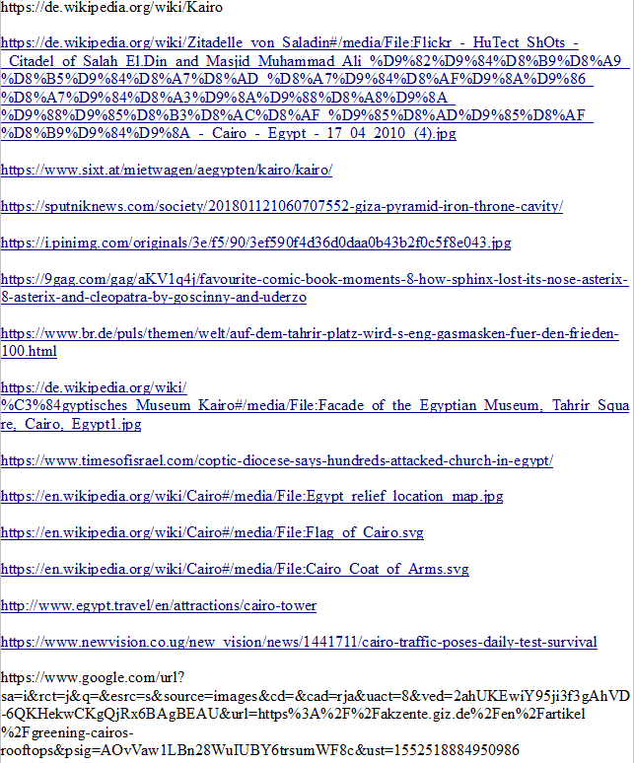
Sources:

